Slide 1
Maximizing Customer Value in E-commerce: Leveraging RFM Analysis and Big Data for Effective Segmentation
Faisal Mumtaz (222394)
Abdul Baqi Malik (222407)

Slide 2
INTRODUCTION
Supply chain optimization through analytics.
Customer segmentation enhances marketing.
Big data reveals customer insights.
RFM analysis for customer segmentation.
Granular segmentation enables targeted marketing.

Slide 3
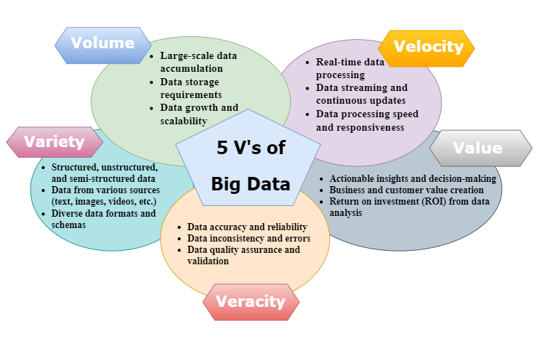

Slide 4
5 v’s of big data
Volume: Comprehensive customer data analysis.
Velocity: Getting insights and making decisions in real-time.
Variety: Looking at various sources of data to understand customer behavior
Veracity: Ensuring data is reliable for accurate segmentation.
Value: Personalized experiences and customer satisfaction

Slide 5
Problem statement
Effective customer segmentation for online retail.
Identifying the most profitable customer segments.
Developing efficient segmentation methods.
Maximizing customer value and profitability.
Comparing different RFM analysis techniques.
Targeted marketing strategies for specific segments.

Slide 6
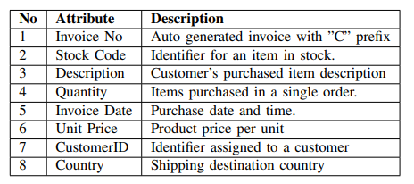
DATASET DESCRIPTION [2]

Slide 7
Customer Segmentation [1]
Dividing the customers into Groups on the basis of
Demographics Segmentation
Need based Segmentation
Geographic Segmentation
Behavioral Segmentation
Many Others

Slide 8
Why we need Customer Segmentation
Target marketing
Resource allocation
Customer Retention
Product development
Market Expansion

Slide 9
Why we are doing Customer Segmentation
To make a better recommendation System on the basis of customer Segments
The customer lies in the same cluster may have same likeness and dis-likeness
It will increase product sale and maximize profit.

Slide 10
How Customer are segmented [4]
We used RFM model for customer segmentation
Recency
Frequency
Monetary

Slide 11
RFM
Recency
Time Since the last transaction
How long has it been since the last purchase by the customer ?
Frequency
How often customer made a purchase over a defined period of time.
Monetary
How much money did the customer paid over a defined period of time

Slide 12
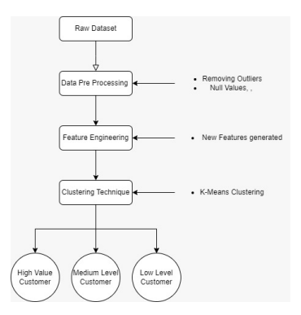
Methodology

Slide 13
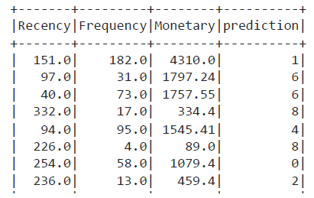
Preprocessing and Feature Engineering [2] [6]
Preprocessing
Outlier Removal
Missing values removed
Feature Engineering
Made new feature
Value
Recency
Frequency
Monetary

Slide 14
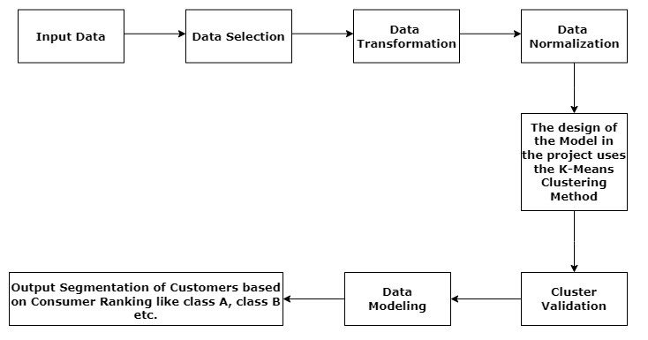
Research Flow Diagram [3]

Slide 15
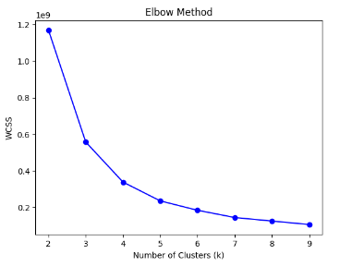
Identifying Number of Clusters [5]
We used elbow method to identify number of clusters.

Slide 16
K mean Clustering
The online retail is unsupervised problem, so we applied clustering methods to identify cluster with similar pattern.
Customer are segmented on the basis of RFM features.

Slide 17
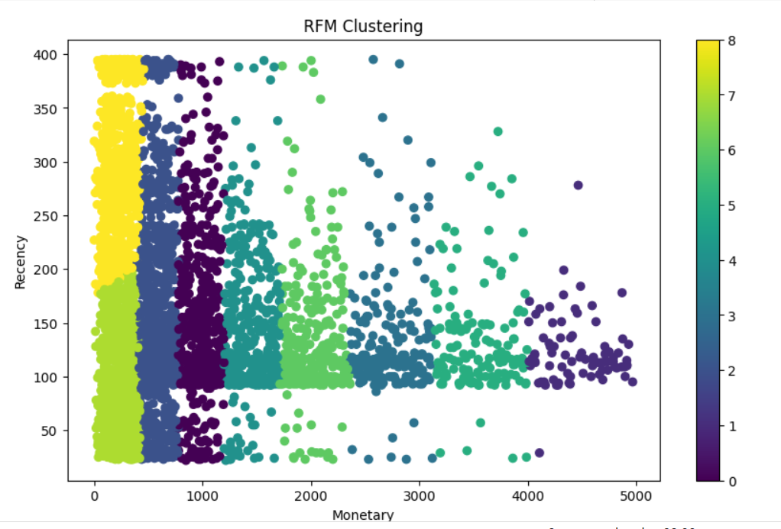
Recency vs Monetary [1]

Slide 18
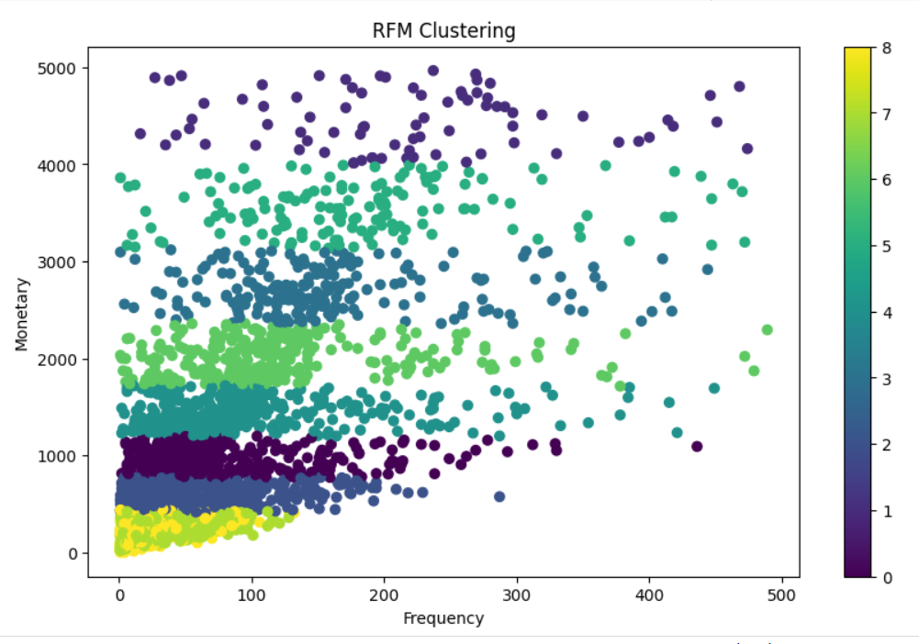
Frequency vs Monetary [4]

Slide 19
Future Direction
We did this project on offline dataset.
On real time or in stream data processing, there are chances that new cluster will appear.
The concept drift may occur due to changes in trend. So cluster may varies and recommendation system needs to update.

Slide 20
REFERENCES
[1] M. A. Kadir and A. Achya, ”Customer Segmentation on Online Retail using RFM Analysis: Big Data Case of Bukku.id,” European Alliance for Innovation (EAI), 2019-09-09.
[2] R. Shirole, L. Salokhe, and S. Jadhav, ”Customer Segmentation using RFM Model and K-Means Clustering,” International Journal of Scientific Research in Science and Technology, vol. 8, no. 3, pp. 591-597, MayJune 2021.
[3] R. W. B. Sembiring, F. A. Mohammed, and K. Chairuang, ”Customer segmentation based on RFM model using K-Means, K-Medoids, and DBSCAN methods,” Lontar Komputer, vol. 11, no. 1, e-ISSN 2541- 5832, April 2020.
[4] I. Kabasakal, ”Customer segmentation based on Recency Frequency Monetary model: A case study in E-Retailing,” J. Inf. Technol., vol. 13, no. 1, pp. 47-56, DergiPark Akademi, 2020
[5] J. Wu, L. Shi, W.-P. Lin, S.-B. Tsai, Y. Li, L. Yang, and G. Xu, ”An empirical study on customer segmentation by purchase behaviors using a RFM model and K-means algorithm,” Math. Probl. Eng., vol. 2020, Article ID 8884227, 7 pages, Hindawi, 19 Nov 2020.
[6] E. Ernawati, S. S. K. Baharin, and F. Kasmin, ”A review of data mining methods in RFM-based customer segmentation,” J. Phys.: Conf. Ser., vol. 2021, Annual Conf. ANCOSET - 2020, IOP Publishing.

